Slide 1
Iam role-sage maker on aws

Slide 3
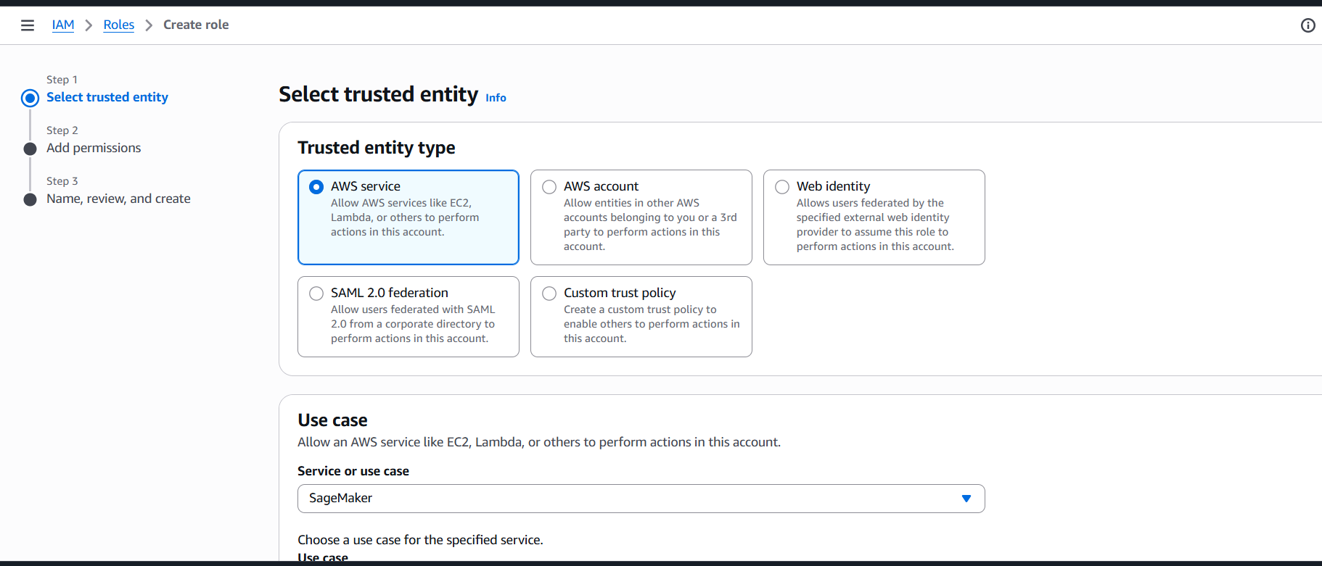

Slide 4
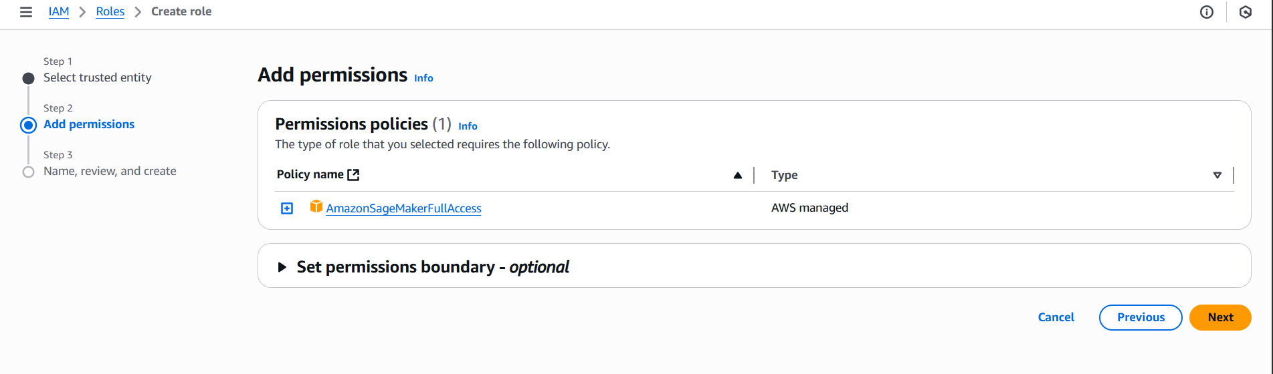

Slide 5
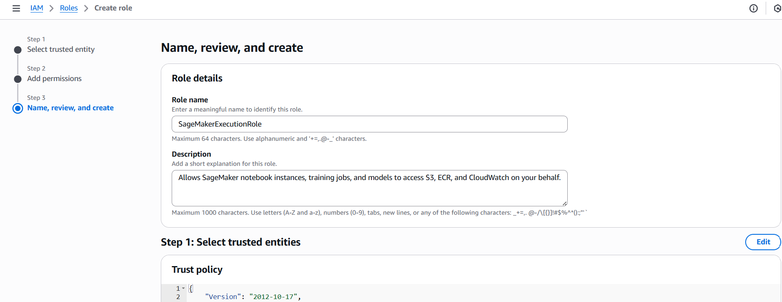

Slide 6
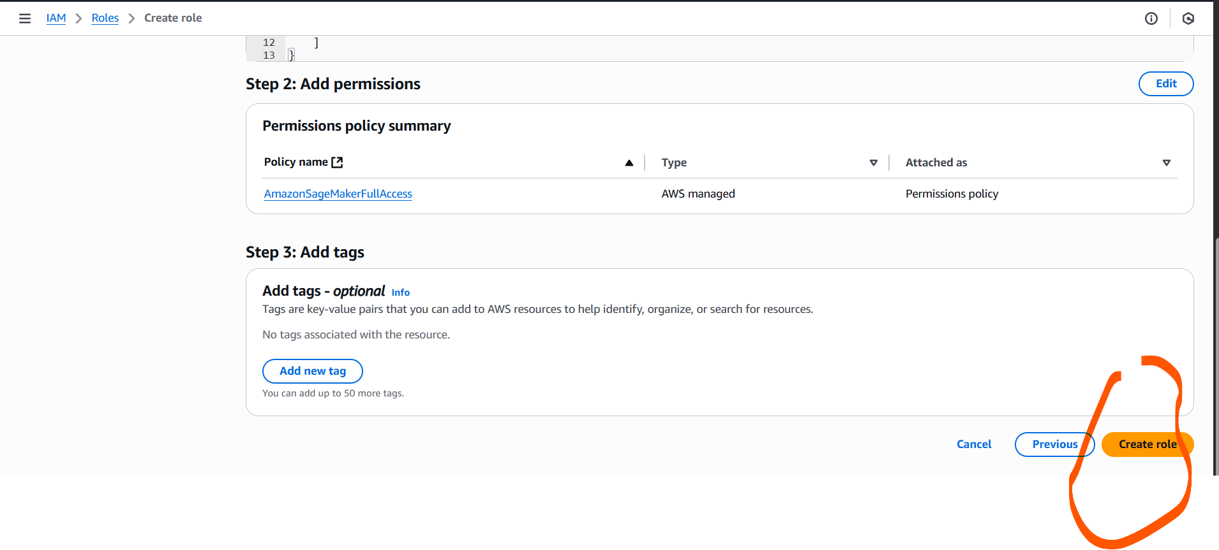

Slide 7
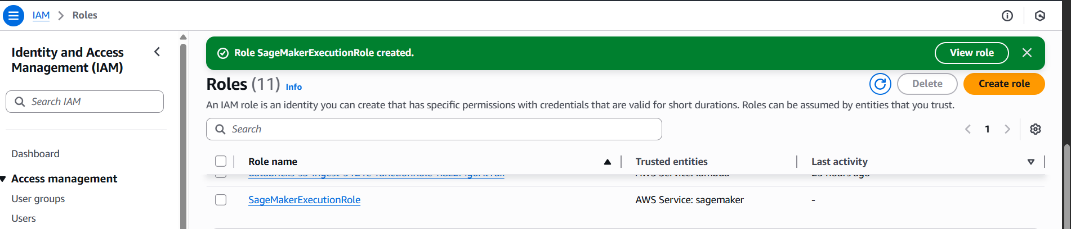

Slide 8
Copy arn
arn:aws:iam::972067303754:role/SageMakerExecutionRole

Slide 9
Cope s3 bucket name and path to replace in script s3://rawgts3/

